Slide 1






Foundations of
Quantum Information Science (QIS 101)
Dave Biersach
Brookhaven National Laboratory
dbiersach@bnl.gov
Session 18
Differential Equations

Slide 2
Session 18 – Goals
How to simulate the trajectory of a circus cannon performer
Implement Euler’s Method for finding numerical solutions to physical laws represented as differential equations
Obtain Euler’s Method from Fermat's definition of the derivative
Model the radioactive decay of Carbon-14 and Fluorine-18
Appreciate the importance of stability in numerical solutions
Use Euler’s Method to model the simple harmonic motion of a single (unforced, undamped) pendulum
Use the Euler-Cromer method to eliminate artificial energy gain in the long-term modeling of a system

Slide 3
Session 18 – Goals
Numerically estimate the solution to a non-linear differential equation using the Runge-Kutta method
Estimate numerical solutions to ordinary differential equations (ODEs) using SciPy
Model the harmonic motion of a simple pendulum using SciPy
Model a damped oscillator to appreciate the impact of critical damping
Analyze the long-term behavior of a harmonograph
Solve coupled non-linear ODEs to model predator-prey dynamics
Build the S-I-R compartment model in epidemiology

Slide 4
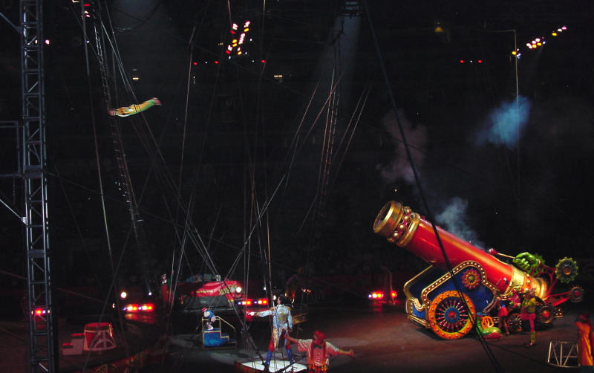
Projectile Motion

Slide 5
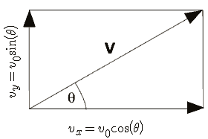
Projectile Motion
$$x=v_{0}∗t∗\cos\left(θ\right)$$
$$y=v_{0}∗t∗\sin\left(θ\right)−\frac{1}{2}gt^{2}$$
$θ= \frac{π}{4}$
$$t= \frac{x}{v_{0}∗\cos\left(θ\right)}$$
Given Range = 400m, what does v₀ need to be?
$$y=\tan\left(θ\right)∗x−\frac{g}{2∗v_{0}^{2}∗\cos^{2}\left(θ\right)}∗x^{2}$$
$$v_{0}=\sqrt{\frac{Range ∗g}{\sin{2θ}}}$$
$$Range= \frac{4h}{tan⁡(θ)}$$
This is the equation of motion that allows us to plot y as x increases from launch point to trampoline
$$h= \frac{v_{0}^{2}\sin^{2}(θ)}{2g}$$

Slide 6
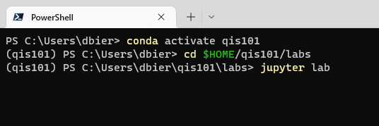
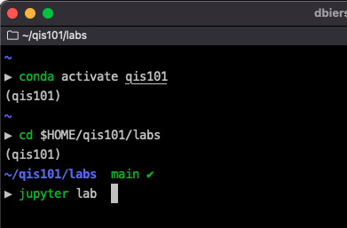
Start Jupyter Lab
conda activate qis101
cd $HOME/qis101/labs
jupyter lab

Slide 7
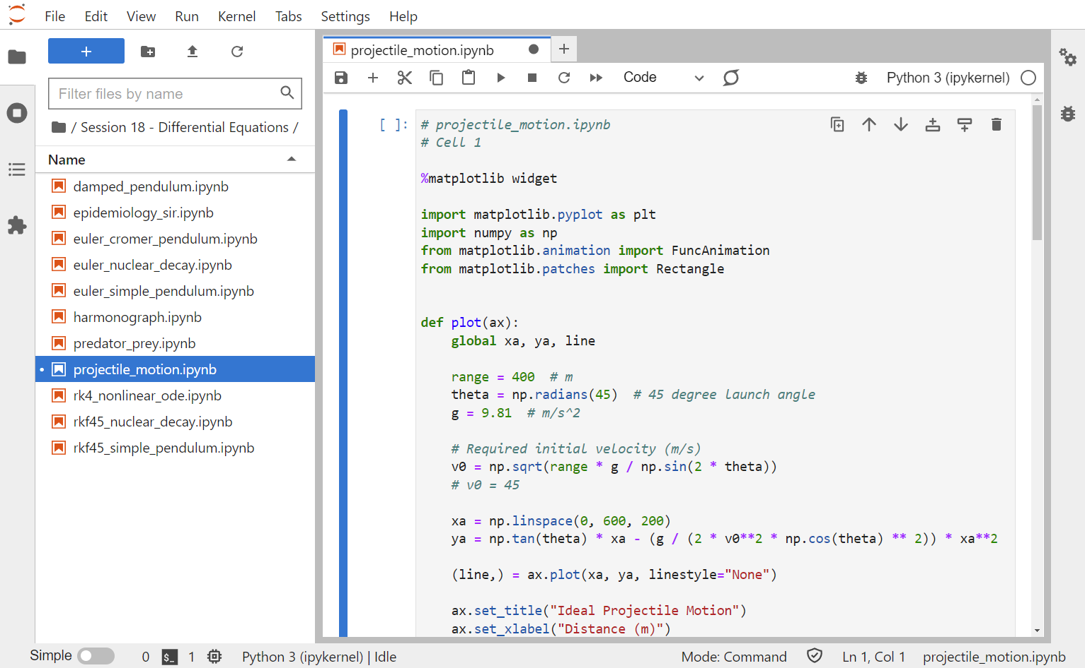
Open projectile_motion.ipynb

Slide 8
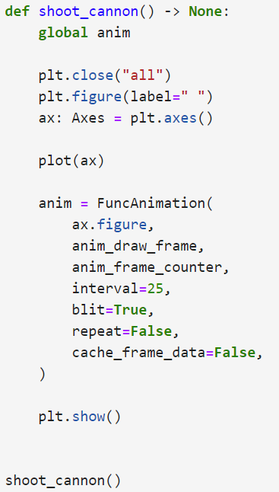
View Cell 1 - projectile_motion.ipynb
②
③
④
⑤
⑥
⑦
⑧
⑨
⑩
①

Slide 9
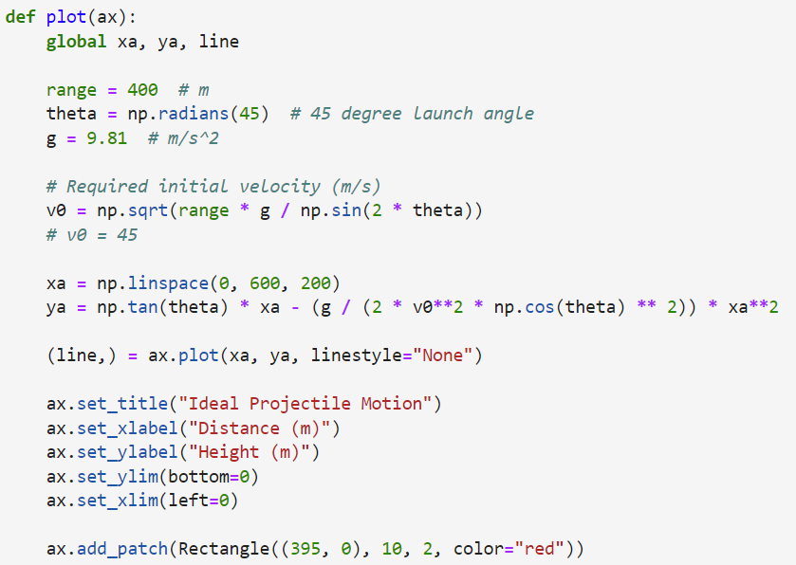
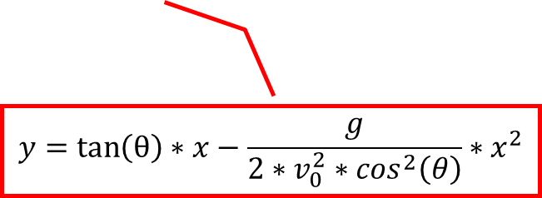
View Cell 1 - projectile_motion.ipynb
①
②
③
④
⑤
⑥
⑦
⑧
⑨
$$y=\tan\left(θ\right)∗x−\frac{g}{2∗v_{0}^{2}∗\cos^{2}\left(θ\right)}∗x^{2}$$
The trampoline is
10m long x 2 m high
⑩

Slide 10
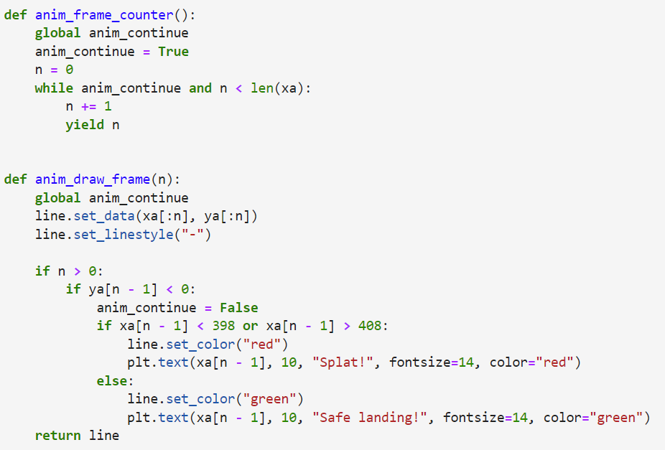
View Cell 1 - projectile_motion.ipynb
①
②
③
④
⑤

Slide 11
View Cell 1 - projectile_motion.ipynb
①
②
③
④
⑤
⑥
⑦
⑧
⑨
⑩

Slide 12
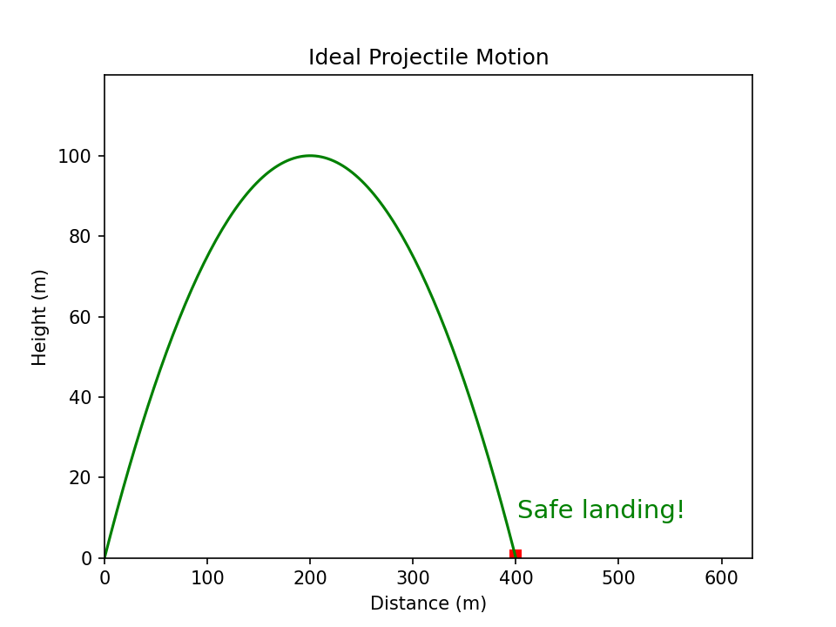
Run Cell 1 - projectile_motion.ipynb

Slide 13
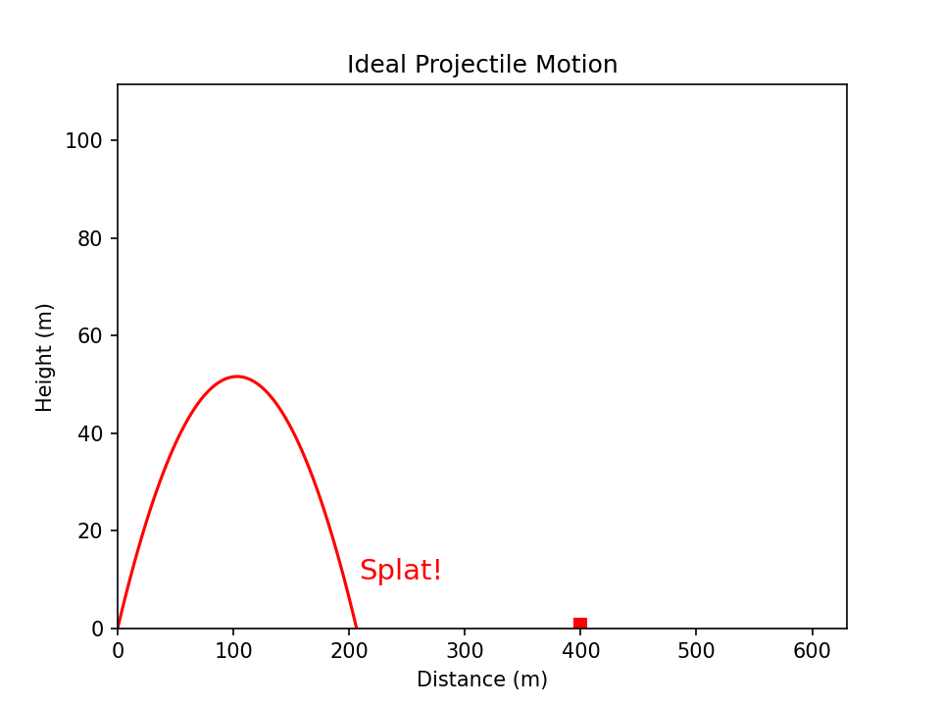
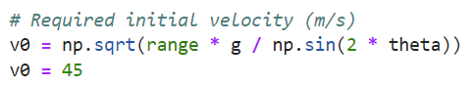
Run Cell 1 - projectile_motion.ipynb
①
The trampoline is 400m from the cannon

Slide 14
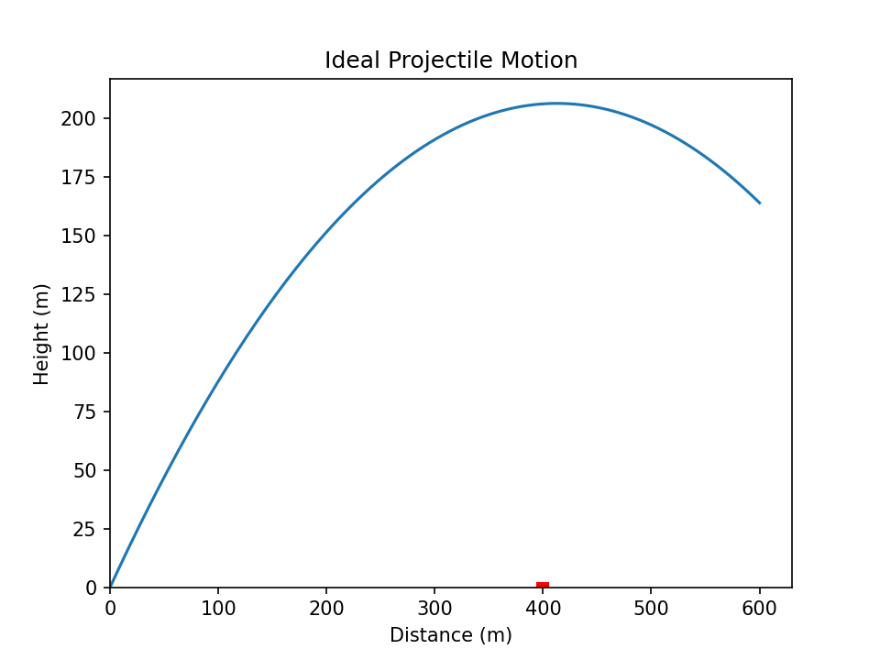

Run Cell 1 - projectile_motion.ipynb
①

Slide 15
Modelling Nuclear Decay
$N\left(t\right)≡$ number of nuclei at time t
$τ≡$ mean lifetime (half life)
$$\frac{dN}{dt}=−\frac{N(t)}{τ}$$
Fermat's Difference Quotient
$$\frac{dN}{dt}=\frac{N\left(t+Δt\right)−N(t)}{Δt}$$
$$−\frac{N(t)}{τ}=\frac{N\left(t+Δt\right)−N(t)}{Δt}$$
$$N\left(t+Δt\right)=N\left(t\right)−\frac{N(t)}{τ}Δt$$
This is Euler’s Method

Slide 16
Modelling Carbon-14 Decay
Radiocarbon dating uses $C^{14}$ isotopes to date items
During their lifetime, organisms absorb a certain amount of Carbon-14 that naturally exists in their environment
When an organism dies, it stops ingesting new Carbon-14 atoms, and the amount already present in the tissues begins to undergo radioactive decay
It is known that $C^{14}$ has a half-life of 5,730 years and at least 0.1% of the original amount of $C^{14}$must be present to be detectable
Given the half-life, how far back in time can scientists can use radiocarbon dating to determine the age of an item?

Slide 17
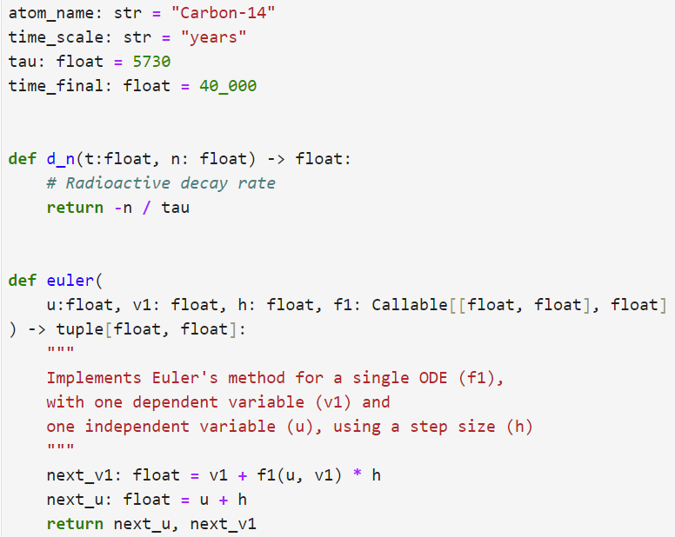
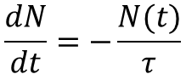
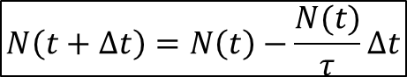
View Cell 1 - euler_nuclear.decay.ipynb
①
②
③
④
⑤
⑥
$$\frac{dN}{dt}=−\frac{N(t)}{τ}$$
⑦
⑧
$$N\left(t+Δt\right)=N\left(t\right)−\frac{N(t)}{τ}Δt$$
⑨
⑩

Slide 18
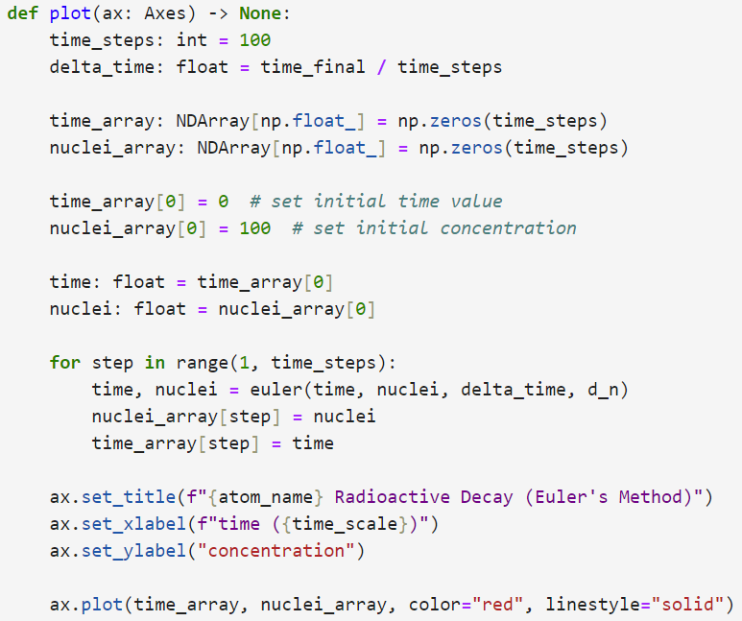
View Cell 1 - euler_nuclear.decay.ipynb
①
②
③
④
⑤
⑥
⑦
⑧
⑨
⑩

Slide 19
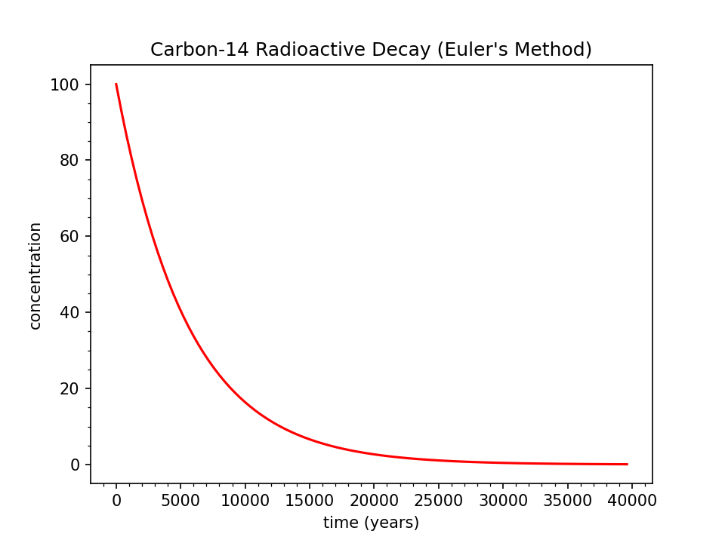
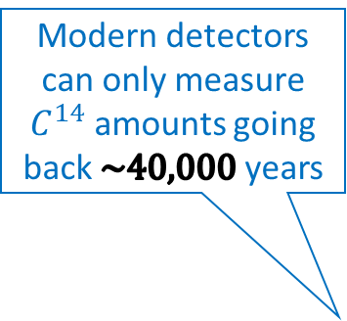
Run Cell 1 - euler_nuclear.decay.ipynb
Modern detectors can only measure $C^{14}$ amounts going back $\sim 40,000$ years
At least 0.1% of the absorbed Carbon-14 must still be present to be detected

Slide 20
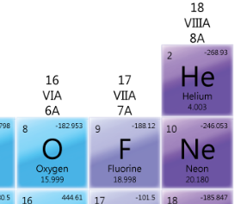
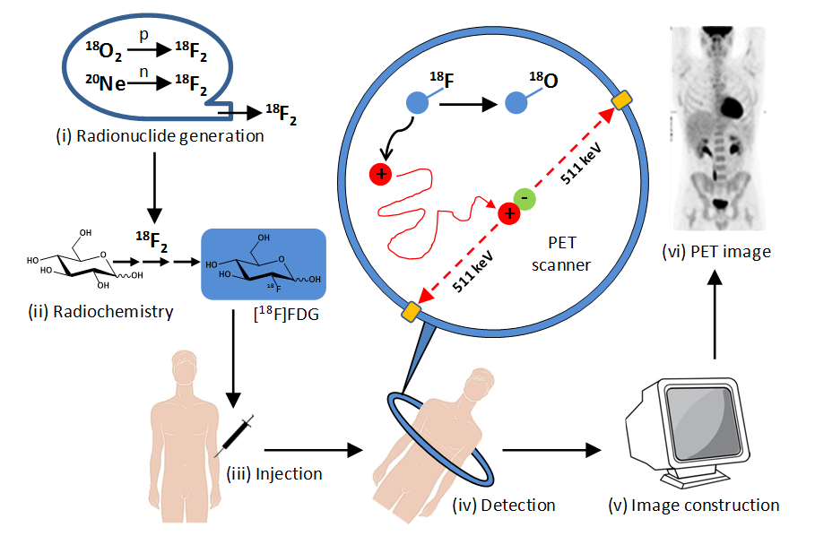
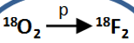

Fluorine-18
At least 5% of the injected Flourine-18 must still be present to be detected

Slide 21
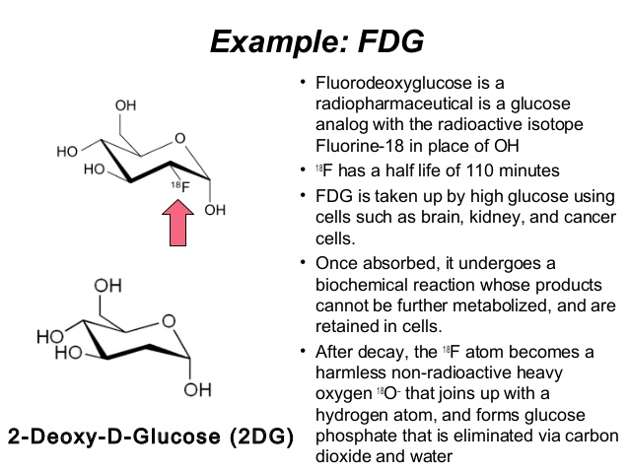
Fluorine-18

Slide 22
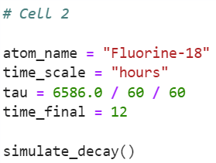
View Cell 2 - euler_nuclear.decay.ipynb

Slide 23
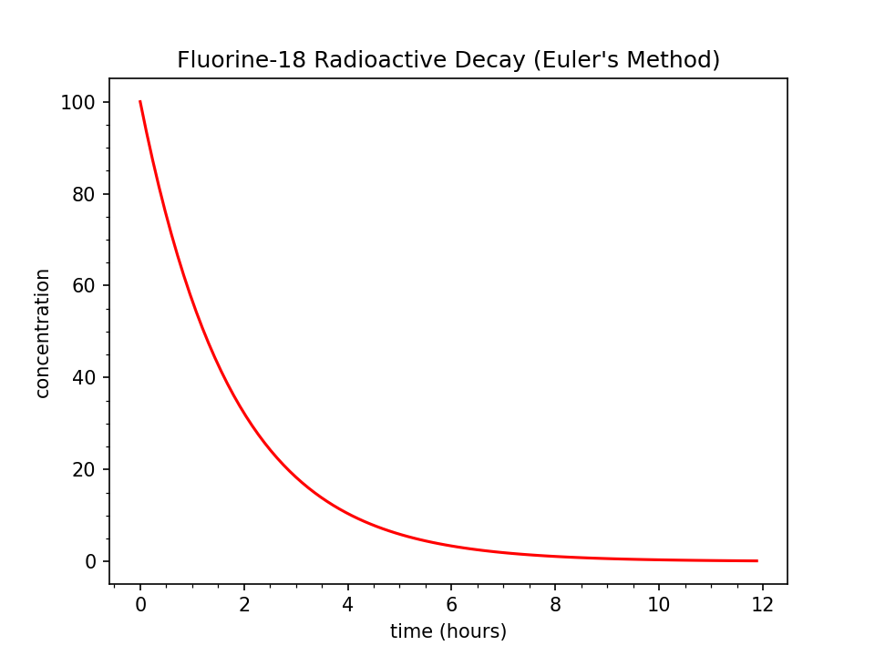
Run Cell 2 - euler_nuclear.decay.ipynb
What two key concepts does this graph suggest?
After 12 hours the ingested Fluorine-18 has decayed enough to not be a lingering threat
Medical staff must get patients into the PET scan within ~5 hours after taking Fluorine-18
At least 5% of the injected Flourine-18 must still be present to be detected

Slide 24

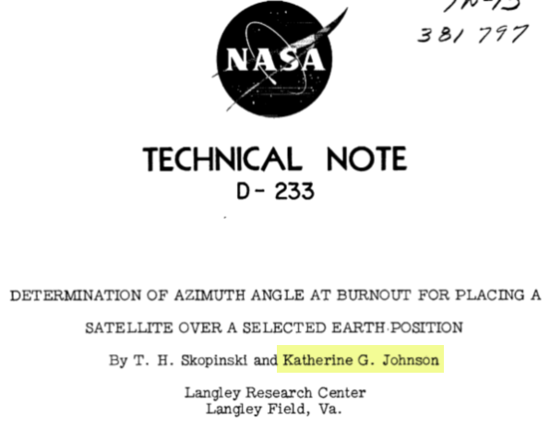
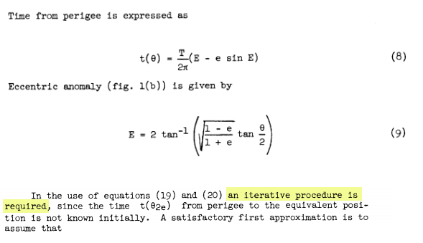
Hidden Figures, Fox 2000 Pictures, 2016
Euler’s Method

Slide 25
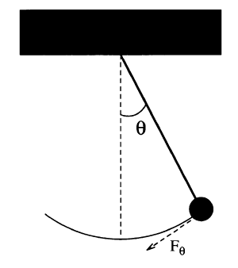
Modelling a Simple Pendulum
Gravity is a restoring force
$$F_{θ}=−mg\sin{θ}$$
$$ml\frac{d^{2}θ}{dt^{2}}=−mg\sin{θ}$$
$$l$$
$$\sin{θ}≈θ \left(for θ<{22}^{°}\right)$$
$$\frac{d^{2}θ}{dt^{2}}=−\frac{g}{l}θ$$
But Euler’s Method works only on first order ODEs! ☹
$$s=lθ$$
$$F=ma$$
$$\frac{d^{2}s}{dt^{2}}=l\frac{d^{2}θ}{dt^{2}}$$
$$F=m\frac{d^{2}s}{dt^{2}}$$
$$\frac{dω}{dt}=−\frac{g}{l}θ$$
We can break the 2nd order ODE into two linked first order ODEs and use Euler’s method on each
$$F_{θ}=ml\frac{d^{2}θ}{dt^{2}}$$
$$\frac{dθ}{dt}=ω$$

Slide 26
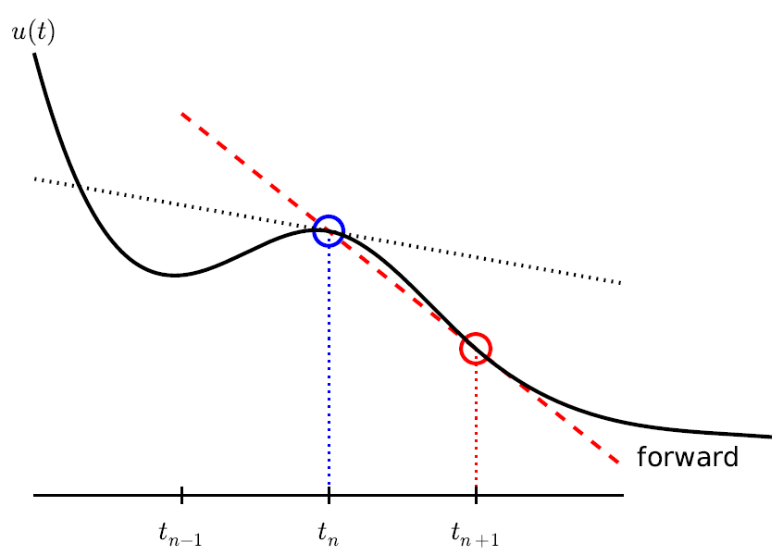
Modelling a Simple Pendulum
$$\frac{dω}{dt}=−\frac{g}{l}θ$$
$$ω_{i+1}=ω_{i}−\frac{g}{l}θ_{i}Δt$$
$$l$$
$$\frac{dθ}{dt}=ω$$
$$θ_{i+1}=θ_{i}+ω_{i}Δt$$
This is Euler’s Method

Slide 27
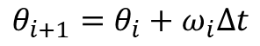
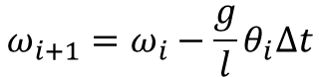
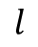
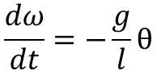
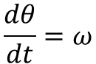
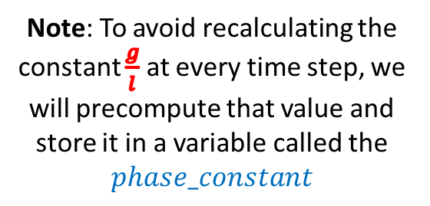
Modelling a Simple Pendulum
$$\frac{dω}{dt}=−\frac{g}{l}θ$$
$$ω_{i+1}=ω_{i}−\frac{g}{l}θ_{i}Δt$$
$$l$$
$$\frac{dθ}{dt}=ω$$
$$θ_{i+1}=θ_{i}+ω_{i}Δt$$
Note: To avoid recalculating the constant $\frac{g}{l}$ at every time step, we will precompute that value and store it in a variable called the
$$phase_constant$$

Slide 28
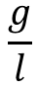
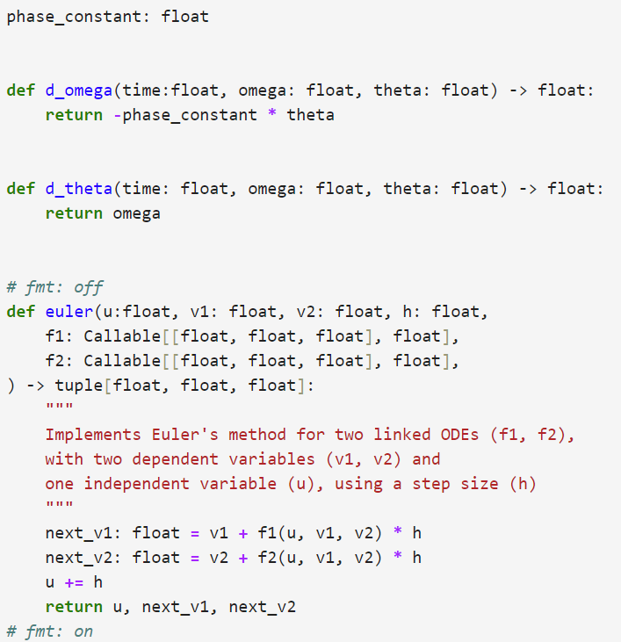
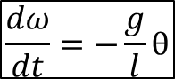
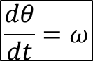
Open euler_simple_pendulum.ipynb
①
②
③
$$\frac{dω}{dt}=−\frac{g}{l}θ$$
④
⑤
$$\frac{dθ}{dt}=ω$$
⑥
⑦
⑧
⑨
⑩

Slide 29
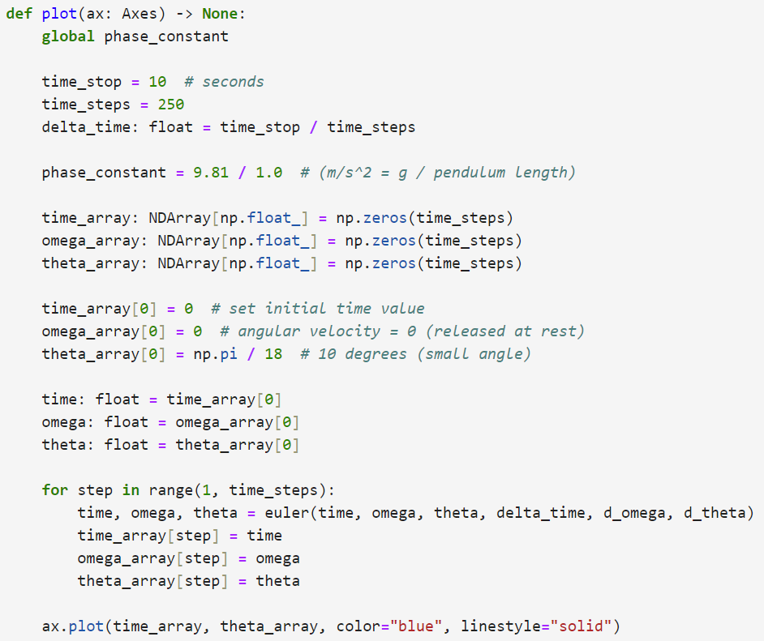
View euler_simple_pendulum.ipynb
①
②
③
④
⑤
⑥
⑦
⑧
⑨
⑩

Slide 30
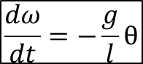
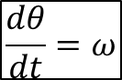
View euler_simple_pendulum.ipynb
$$\frac{dω}{dt}=−\frac{g}{l}θ$$
$$\frac{dθ}{dt}=ω$$
①
②
③
④

Slide 31
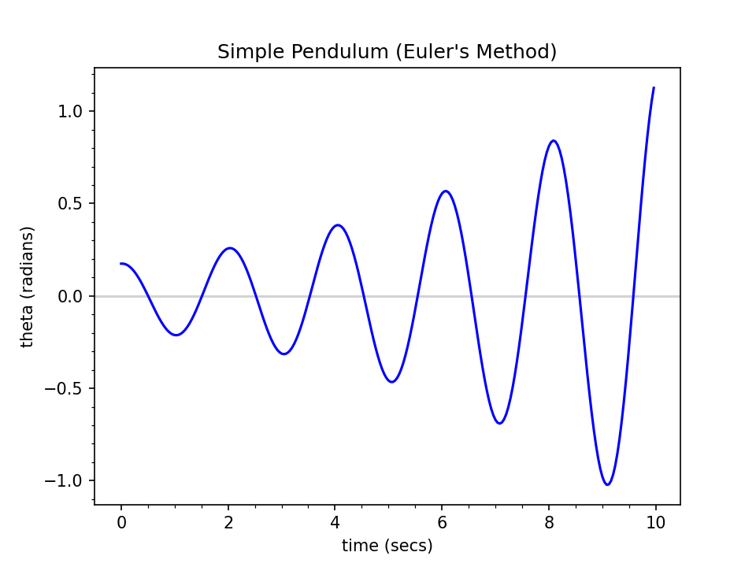
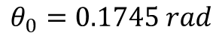
Run euler_simple_pendulum.ipynb
Pendulum angular displacement from centerline
$$θ_{0}=0.1745 rad$$
This is not good… The model predicts the pendulum will begin to swing wildly, which would not happen naturally!

Slide 32
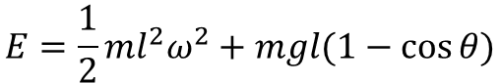
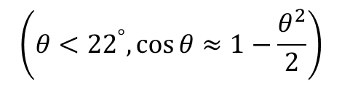
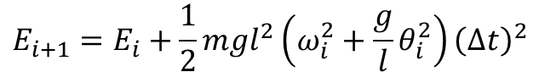
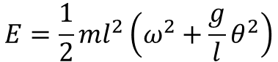
Instability of Euler Method For Highly Oscillatory Modes
kinetic
potential
Increasing time_steps by 10x does not prevent the displacement from growing after each oscillation
This simple Euler method worked fine for modelling radioactive decay – but it is unstable for harmonic motion
The energy in the system is artificially growing over time without any bounds
$$E=\frac{1}{2}ml^{2}ω^{2}+mgl(1−\cos{θ})$$
$$\left(θ<{22}^{°},\cos{θ}≈1−\frac{θ^{2}}{2}\right)$$
$$E=\frac{1}{2}ml^{2}\left(ω^{2}+\frac{g}{l}θ^{2}\right)$$
$$E_{i+1}=E_{i}+\frac{1}{2}mgl^{2}\left(ω_{i}^{2}+\frac{g}{l}θ_{i}^{2}\right){\left(Δt\right)}^{2}$$
Due to the squaring of values,
the next energy state will always be incorrectly larger than the previous energy state

Slide 33
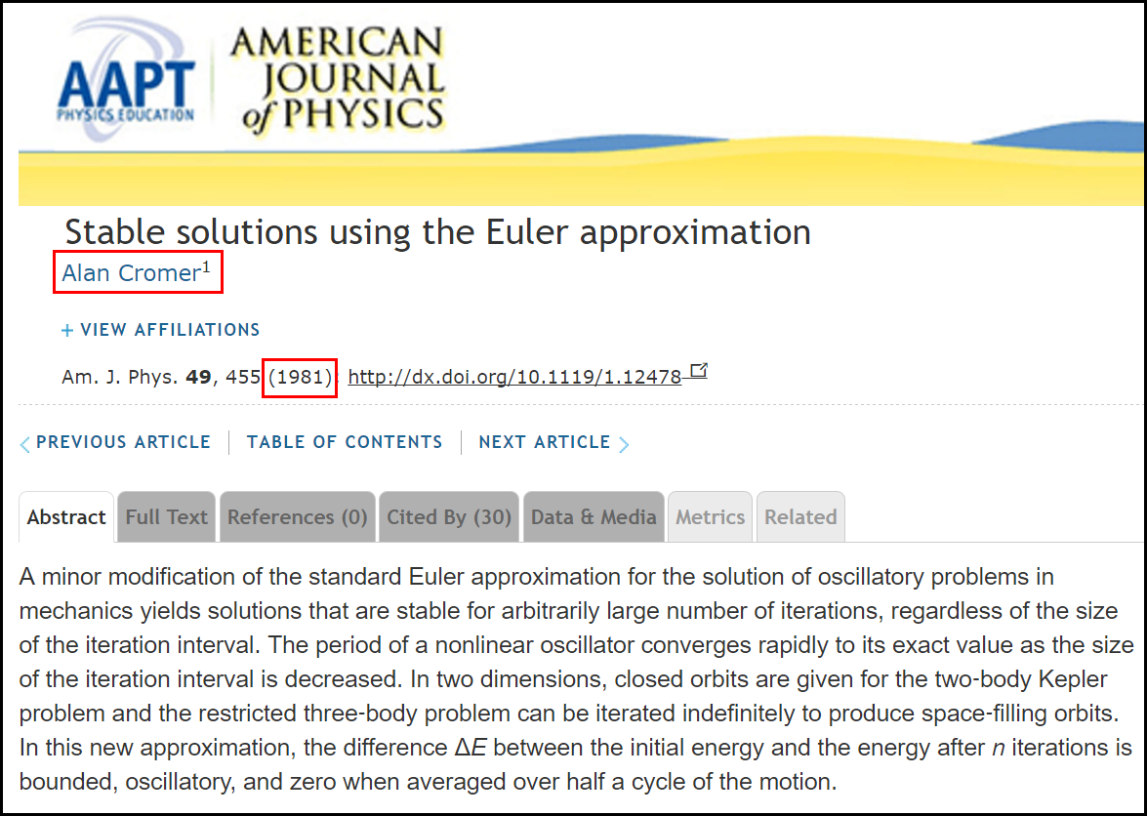
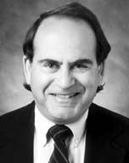

The Euler-Cromer Method

Slide 34



Open euler_cromer_pendulum.ipynb
Euler
$$ω_{i+1}=ω_{i}−\frac{g}{l}θ_{i}Δt$$
$$θ_{i+1}=θ_{i}+ω_{i}Δt$$
Euler's Mistake
Euler-Cromer
$$ω_{i+1}=ω_{i}−\frac{g}{l}θ_{i}Δt$$
$$θ_{i+1}=θ_{i}+ω_{i+1}Δt$$

Slide 35


Run euler_cromer_pendulum.ipynb
$$θ_{0}={10}^{°}$$
The model is now stable as iteration of the numerical method does not add false energy to the system.

Slide 36
Runge-Kutta Methods
Around 1900, two German mathematicians, Carl Runge and Wilhelm Kutta, wanted to improve the accuracy of Euler's Method
Following the same motivation underlying Simpson's Rule for numerical integration, they developed a method of interpolating a curve between the endpoints of a sampled interval
Using a weighted combination of tangent lines sampled throughout an interval, a more accurate derivative can be calculated than using the single tangent line in Euler's Method

Slide 37




Runge-Kutta Methods

Slide 38











Runge-Kutta Methods
$$\frac{dy}{dx}=y∙\cos{x} y\left(0\right)=1$$
$$\ln{y}=\sin{x}+c$$
$$y=ce^{\sin{x}}$$
$$\left(\frac{1}{y}\right)\frac{dy}{dx}=\cos{x}$$
Initial Value
$$y\left(0\right)=1→c=1$$
$$\int{\frac{1}{y}ⅆy}=\int{\left(\cos{x}\right)ⅆx}$$
$$y=e^{\sin{x}}$$
Check
$$\ln{y}+c=\sin{x}+c$$
$$\frac{d}{dx}\left(e^{\sin{x}}\right)=\frac{d}{du}\left(e^{u}\right)\frac{du}{dx} ,u=\sin{x}$$
$${=e}^{\sin{x}}\left(\frac{d}{dx}\left(\sin{x}\right)\right)$$
$$=e^{\sin{x}}∙\cos{x}$$

Slide 39


Open rk4_nonlinear_ode.ipynb
①
②
$$\frac{dy}{dx}=y∙\cos{x}$$
③
④
⑤
⑥
⑦
⑧

Slide 40

Run rk4_nonlinear_ode.ipynb
Euler's Method continues to lose accuracy each iteration

Slide 41

Runge-Kutta Methods

Slide 42
Solve ODEs with SciPy
We often must numerically solve systems of differential equations so we can simulate dynamic models
The Python package SciPy contains several ready-to-use numerical methods to estimate the solution to a variety of differential equations
Ordinary and Partial Differential Equations (ODE/PDE)
Linear and Non-Linear Differential Equations
Initial Value Problem (IVP) and Boundary Value Problems (BVP)
Both Individual and Systems of Linked Differential Equations

Slide 43

Scientific Computing with Python
https://scipy.org

Slide 44

Scientific Computing with Python

Slide 45

Open rkf45_nuclear_decay.ipynb
SciPy uses RKF45 which is Fehlberg's enhancement to classic 4th-order Runge-Kutta
①
②
③
④

Slide 46


Open rkf45_nuclear_decay.ipynb
⑥
⑦
⑨
$$\frac{dN}{dt}=−\frac{N(t)}{τ}$$
⑩
①
②
③
④
⑤
⑧

Slide 47
Open rkf45_nuclear_decay.ipynb
⑤
⑥
①
②
③
④
⑦
⑧
⑨

Slide 48

Run Cell 1 - rkf45_nuclear_decay.ipynb

Slide 49

Run Cell 2 - rkf45_nuclear_decay.ipynb

Slide 50
Modelling a Simple Pendulum
Gravity is a restoring force
$$F_{θ}=−mg\sin{θ}$$
$$ml\frac{d^{2}θ}{dt^{2}}=−mg\sin{θ}$$
$$l$$
$$\frac{d^{2}θ}{dt^{2}}=−\frac{g}{l}\sin{θ}$$
We are no longer constrained to the small angle identity
$$s=0$$
$$s=lθ$$
$$F=ma$$
$$\frac{dω}{dt}=−\frac{g}{l}\sin{θ}$$
We can break the 2nd order ODE into two linked 1st order ODEs
$$\frac{d^{2}s}{dt^{2}}=l\frac{d^{2}θ}{dt^{2}}$$
$$F=m\frac{d^{2}s}{dt^{2}}$$
$$\frac{dθ}{dt}=ω$$
$$F_{θ}=ml\frac{d^{2}θ}{dt^{2}}$$

Slide 51


Open rkf45_simple_pendulum.ipynb
①
$$\frac{d^{2}θ}{dt^{2}}=−\frac{g}{l}\sin{θ}$$
②
③
④
⑤
⑥
⑦
⑧
⑨
⑩

Slide 52


View rkf45_simple_pendulum.ipynb
①
②
③
④
$$\frac{d^{2}θ}{dt^{2}}=−\frac{g}{l}\sin{θ}$$
$$\frac{dω}{dt}=−\frac{g}{l}\sin{θ}$$
$$\frac{dθ}{dt}=ω$$

Slide 53


Run rkf45_simple_pendulum.ipynb
①
②
$$θ_{0}={75}^{°}$$
What is the physics story at these circled times?

Slide 54
Damped Harmonic Oscillator
In real oscillators, friction (or damping) slows the motion of the system. Due to frictional force, the velocity decreases in proportion to the acting frictional force
In contrast to a simple undriven harmonic oscillator (where the only force acting on the mass is the restoring force) in a damped harmonic oscillator there is in addition a frictional force which is always acts in the direction opposing the motion
We always strive to develop mathematical models that are as realistic as possible – friction is hard to avoid in the real world and therefore should not be ignored in a simulation

Slide 55



Damped Harmonic Oscillator
$$\frac{d^{2}θ}{dt^{2}}=−\frac{g}{l}\sin{θ}$$
We can introduce a new resistive force term into the equation of motion for a pendulum
$$\frac{d^{2}θ}{dt^{2}}=−q\frac{dθ}{dt}−\frac{g}{l}\sin{θ}$$
$q$= damping_constant
$$\frac{dω}{dt}=−qω−\frac{g}{l}\sin{θ}$$
$$\frac{dθ}{dt}=ω$$

Slide 56


Damped Harmonic Oscillator
Underdamped – The system swings back and forth (oscillates) over its equilibrium point, but ultimately comes to rest
Example: $q=1$
Overdamped – The system never oscillates, but it takes a while for it to return to its equilibrium point
$$\text{Example}\text{:} q=\frac{{\left(phase_constant\right)}^{2}}{2}$$
Critically damped – The system never oscillates and returns to its equilibrium point in the least amount of time
$$q=\frac{{\left(phase_constant\right)}^{2}}{4}$$
Note: There is only one value for $q$ where the system is critically damped

Slide 57






Open damped_pendulum.ipynb
$$\frac{d^{2}θ}{dt^{2}}=−q\frac{dθ}{dt}−\frac{g}{l}\sin{θ}$$
①
②
③
④
⑤
⑥
⑦

Slide 58

Run damped_pendulum.ipynb
In what applications would you want a system to be critically damped?

Slide 59


Tuned Mass Dampers
Taipei 101 – Taiwan
The Worlds Tallest Building (2004-2009)
730 Tons

Slide 60

Tuned Mass Dampers
365 Minivans

Slide 61

Coupled Harmonograph

Slide 62


Coupled Harmonograph
Each pendulum controls the X or Y displacement

Slide 63



Open harmonograph.ipynb
①
②
③
⑦
④
⑤
⑥
⑧
⑨
$$\frac{dω}{dt}=−\frac{g}{l}\sin{θ}$$
$$l_{1}≠l_{2}$$
$$θ_{1i}=θ_{2i}$$
$$ω_{1i}=ω_{2i}$$
$$\frac{dθ}{dt}=ω$$
⑩

Slide 64


Run Cell 1 – harmonograph.ipynb
$$l_{1}≠l_{2}$$
$$θ_{1i}=θ_{2i}$$
$$ω_{1i}=ω_{2i}$$

Slide 65


Lissajous Figures

Slide 66

Lissajous Orbits

Slide 67

Lissajous Orbits
Lagrange Point
Lagrange Point

Slide 68

Lissajous Orbits
A Halo Orbit

Slide 69


Slide 70



Predator-Prey Modelling
https://en.wikipedia.org/wiki/Lotka-Volterra Equations
1925
Visualize the Lotka-Volterra differential equations
with these characteristics & initial conditions:
$$α=2, β=1.1, γ=1.0, δ=0.9$$
$$x\left(0\right)=1, y\left(0\right)=0.5$$
In this model, at any time$t$ :
$x\left(t\right)$ represents the prey population
$y\left(t\right)$ represents predator population
Alfred Lotka
$α=$ Prey Birth Rate
$β=$ Prey Death Rate
$γ=$ Pred Death Rate
$δ=$ Pred Birth Rate
The solution to their system of coupled non-linear 1st order differential equations can be numerically estimated using the scicpy solve_ivp function
Vito Volterra

Slide 71

Open predator_prey.ipynb
①
②
③
$α=2.0$ Prey Birth Rate
$β=1.1$ Prey Death Rate
$γ=1.0$ Pred Birth Rate
$δ=0.9$ Pred Death Rate
④
$$x\left(0\right)=1, y\left(0\right)=0.5$$
⑤
At time$t$ :
$x\left(t\right)=$ prey population
$y\left(t\right)=$ predator population
⑥
⑦
⑧

Slide 72

Run predator_prey.ipynb
What story is this graph telling?

Slide 73


Modelling Infectious Diseases
Based upon the work of Hudson and Ross, the Kermack-McKendrick (1933) S-I-R equations model the spread of infectious diseases throughout a population
$$\frac{ⅆS}{ⅆt}=−βSI$$
$$\frac{ⅆI}{ⅆt}=βSI−δI$$
$$\frac{ⅆR}{ⅆt}=δI$$
$S(t)$ = Susceptible population
$I(t)$ = Infected population
$R(t)$ = Recovered population
Hilda Hudson
$β=$ Infection rate factor
$δ=$ Recovery rate factor
As time progresses, the population changes from one compartment to the next: $S→I→R$
Note: the total population in this model does not change
Ronald Ross
We seek the functions $S\left(t\right), I\left(t\right),and R(t)$

Slide 74


Modelling Infectious Diseases
$β=$ Infection rate factor
$δ=$ Recovery rate factor
As people become infected, the susceptible population decreases
As more people are infected, the faster the disease is spread to the susceptible
$$\frac{ⅆS}{ⅆt}=−βSI$$
William Kermack
Having more susceptible people makes it easier for the infection to find a new host
Susceptible people become infected (𝜷) and infected people become recovered ($δ$)
$$\frac{ⅆI}{ⅆt}=βSI−δI$$
The number of recovered people increases over time
$$\frac{ⅆR}{ⅆt}=δI$$
Anderson McKendrick

Slide 75

Open epidemiology_sir.ipynb
①
$β=$ Infection rate factor
$δ=$ Recovery rate factor
$$\frac{ⅆS}{ⅆt}=−βSI$$
$$\frac{ⅆI}{ⅆt}=βSI−δI$$
$$\frac{ⅆR}{ⅆt}=δI$$
②
③
④
⑤
⑥

Slide 76

Run epidemiology_sir.ipynb
What story is this graph telling?

Slide 77
SIR Model Epidemiology
The infected population will decrease more slowly than it rises, hence it takes much longer to rid a population of an infection than it takes for the initial infection to spread
A percentage of people will remain susceptible for a very long time - hence the need for an ongoing vaccination program – think about smallpox, polio, etc.

Slide 78

Session 18 – Know You Know…
How to develop the equations of motion to accurately plot the 2D trajectory of a projectile moving through a uniform gravitational field
Euler’s Method (forward-in-time step analysis) yields numeric solutions to differential equations
We can model 2nd order differentials by representing them as a chain of linked 1st order equations
Euler-Cromer is better when modelling harmonic oscillators
A higher-order approach like Runge-Kutta improves accuracy
Increasing the number of time steps (decreasing $∆t)$ improves the accuracy of the estimations but then requires more time to run

Slide 79
Session 18 – Know You Know…
The scipy package has many numerical solvers for systems of differential equations
Even a simple set of linked differential equations can yield highly complex long-term behavior of systems
Most dynamical systems have critical values that are related to its fundamental equilibrium points (consider the damping constant)
The S-I-R epidemiology models have been greatly enhanced by modern research in computational biology
We can estimate solutions to systems of linked non-linear ODEs using the Runge-Kutta Method
The language of all science is Differential Equations – please try to learn about them!

Slide 80

Task 18-01
Edit Cell 2 of harmonograph.ipynb to reproduce this ellipse:
Upload your solution to the BNL QIS101 SharePoint site

Slide 81


Task 18-02
Create a Jupyter Lab notebook file called rlc_circuit.ipynb
Your code should plot the current over time flowing through an RLC circuit that maintains a constant DC voltage
Use SciPy to estimate this 2nd order homogenous ODE out to 1 second in duration using these values
Upload your solution to the BNL QIS101 SharePoint site
$$\frac{d^{2}}{{dt}^{2}}I\left(t\right)=−\frac{R}{L}\frac{d}{dt}I\left(t\right)−\frac{1}{LC}I(t)$$
R = 0.1 Ohms
L = 0.01 Henries
C = 0.01 Farads
Initial I = 1 Amp

Slide 82

Task 18-02

